Slide 1
SOCIAL ENGINEERING
Submitted in the partial fulfillment for the award of the degree of
BACHELOR OF ENGINEERING
IN
COMPUTER SCIENCE AND ENGINEERING (Hons.)INFORMATION SECURITY
Submitted by:
Kartik Kumar –21BCS8403
Pratik Mukharjee - 21BCS8404
Krishma - 21BCS8405
Under the Supervision of:
Ms. Priyanka Jammwal (E15553)
Department of AIT-CSE
DISCOVER . LEARN . EMPOWER

Slide 2
Outline
Introduction to Project
Problem Formulation
Objectives of the work
Methodology used
Results and Outputs
Conclusion
Future Scope
References

Slide 3
Introduction
Social engineering is the psychological manipulation of individuals to gain confidential information or unauthorized access.
Phishing becomes a main area of concern for security researchers because it is not difficult to create the fake website which looks so close to legitimate website. Experts can identify fake websites but not all the users can identify the fake website and such users become the victim of phishing attack.
Main aim of the attacker is to steal banks account credentials. Phishing attacks are becoming successful because lack of user awareness. Since phishing attack exploits the weaknesses found in users, it is very difficult to mitigate them but it is very important to enhance phishing detection techniques.

Slide 4
Objectives of the Work
The project’s objectives are as follows:
To study various Social Engineering techniques and methods.
To identify the appropriate machine learning techniques and define a solution using the selected method.
To select an appropriate dataset for the problem statement.
To apply appropriate algorithms to achieve the solution to phishing attacks.
To safeguard online users from becoming victims of online fraud, sharing confidential information to an attacker among other effective uses of phishing as an attacker’s tool, phishing detection tools play a vital role in ensuring a secure online experience for users.
.

Slide 5
Problem Formulation
The problem formulation for this project can be broken down into following steps:
There are many Anti phishing techniques that helps us protect from phishing sites. Mozilla Firefox, Safari and Google chrome makes use of Google Safe Browsing (GSB) [13] service that will block the phishing websites.
The main disadvantage of GSB was that it was unable to detect the phishing website since updating of blacklist was not done. In case of Net craft, a website that phishing was recorded as phishing although it wasn’t blocked. The blocking is done by Net craft only when it is sure 100% that the website is phishing.
Hence the focus of the project is on overcoming the disadvantage of GSB using machine learning (ML) methods for network analysis of intrusion detection.
One of the most widely used algorithm in machine learning technology. Decision tree algorithm is easy to understand and also easy to implement. Decision tree begins its work by choosing best splitter from the available attributes for classification which is considered as a root of the tree.
Random forest algorithm is one of the most powerful algorithms in machine learning technology and it based on concept of decision tree algorithm. Random forest algorithm creates the forest with number of decision trees. High number of trees gives high detection accuracy.

Slide 6
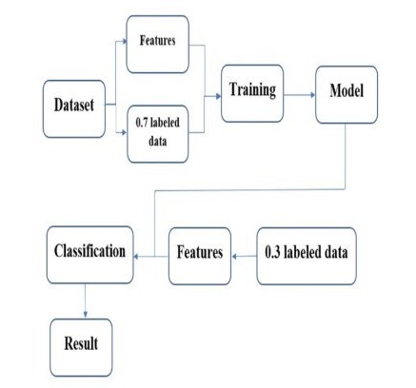
Methodology used
Dataset
Data Pre-Processing
Feature Extraction
Evaluation
Training

Slide 7
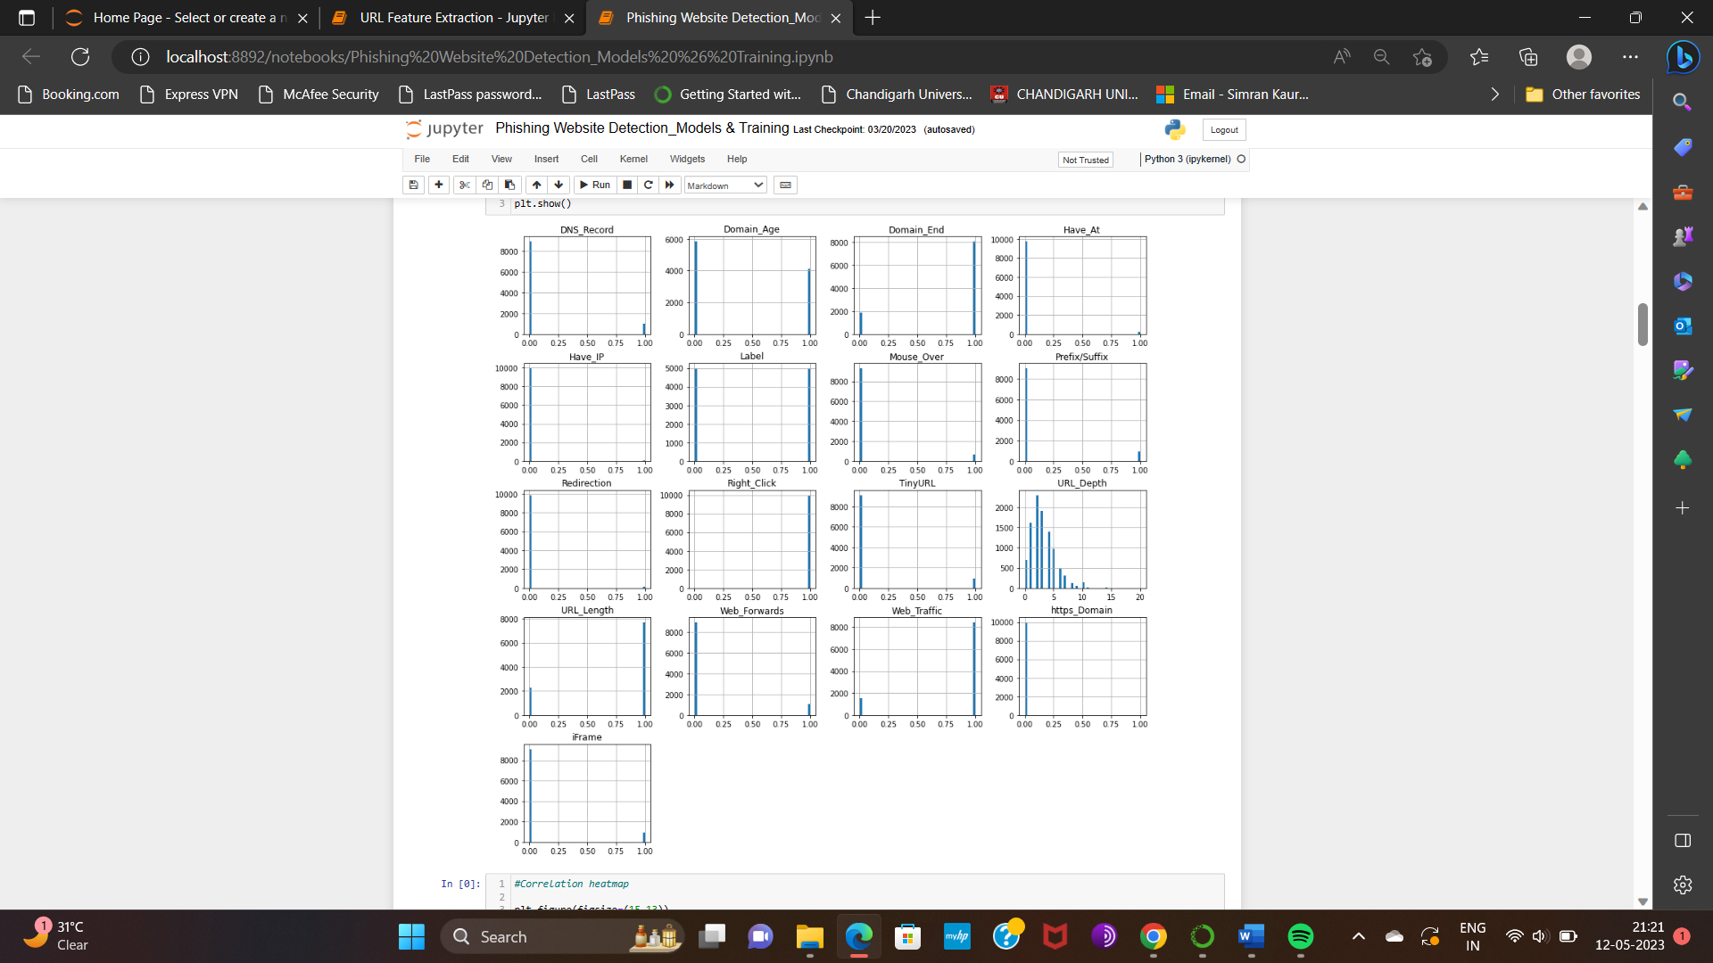
Output
Fig.1Plotting the data distribution

Slide 8
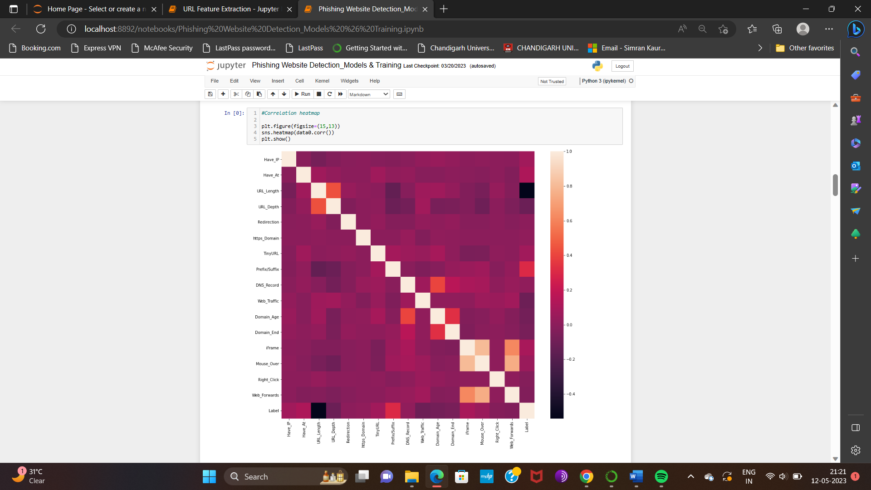
Output
Fig.2 Correlation heatmap

Slide 9
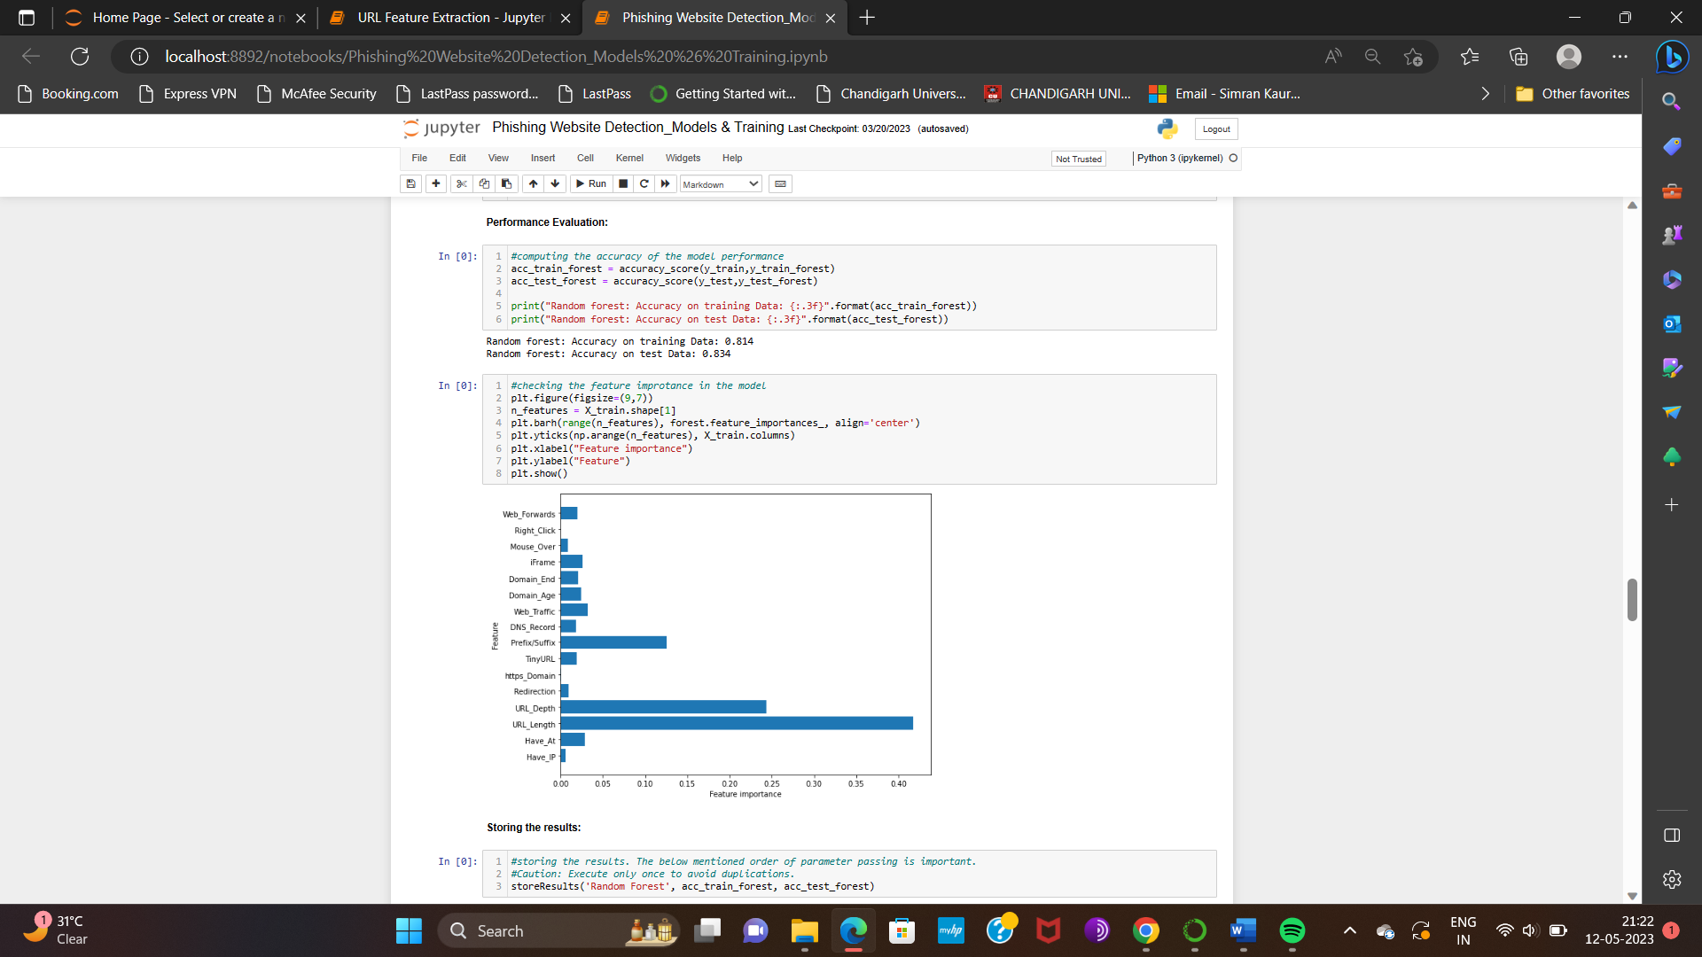
Output
Fig.2 Checking the feature importance in the Model using Random Forest classifier.

Slide 10
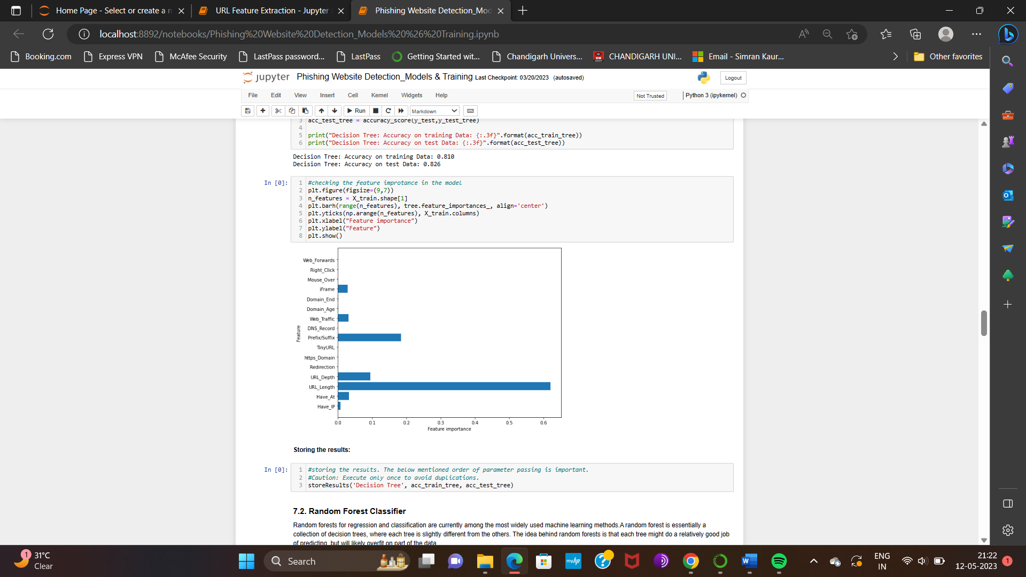
Output
Fig.4Checking the feature importance in the Model using Decision Tree classifier.

Slide 11
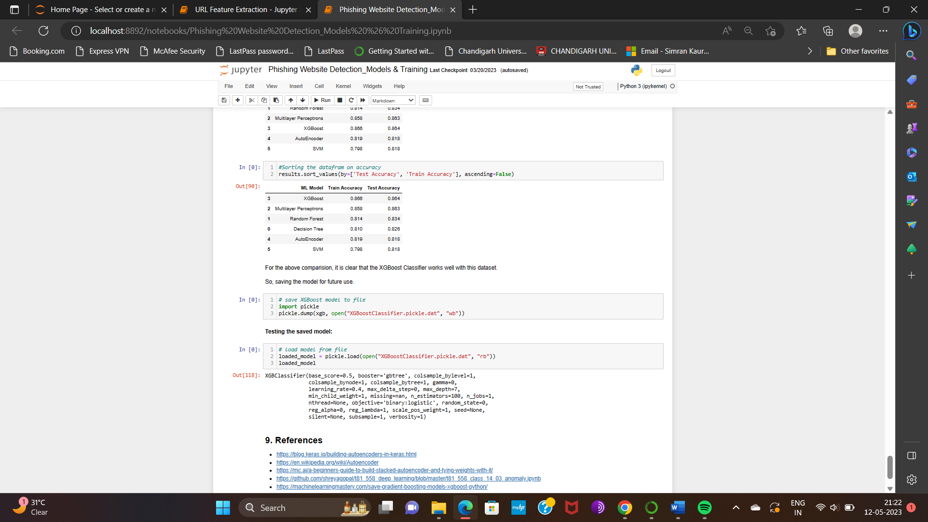
Output
Fig.5Comparing the Models.

Slide 12
Conclusion
Phishing attack have become a prevalent issue. Phishing attacks are intelligently crafted social engineering attacks in which victims are conned by email to provide sensitive information and then directly send it to the phisher. It is more likely that young users will fall prey to phishing attacks because of their naiveté. Additionally, users with the trait of agreeable behaviour are more likely to be lured by phishing scams than those with the trait of disagreeable behaviour. Women are more likely to provide their personal and financial details to fraud emails and websites. There is a causal relationship between gender and social engineering that can be explained by internet usage patterns. So, detection of that type of email is necessary. There are numerous techniques for detecting phishing emails. However, there are a few limitations, such as a low level of accuracy. The content material may be the same as legitimate email so it cannot be detected, the detection rate is not high. This study utilized machine learning techniques to attain superior outcomes and capture inherent attributes of the email text and other characteristics for classifying emails as either phishing or non-phishing. The results of this research have improved the accuracy of detecting phishing emails. A comparison between three supervised datasets was conducted between these classifiers. Numerous machine learning algorithms exhibit efficient classification with strong performance metrics. In this article, we conducted a study of the phishing detection process and phishing detection techniques presented in recent research literature.

Slide 13
Future Scope
In future if we get structured dataset of phishing we can perform phishing detection much more faster than any other technique.
In future we can use a combination of any other two or more classifier to get maximum accuracy. We also plan to explore various phishing techniques that uses Lexical features, Network based features, Content based features, Webpage based features of web pages which can improve the performance of the system.
In particular, we extract features from URLs and pass it through the various classifiers.
We noted that Feature selection techniques need more improvement to cope with the continuous development of new techniques by the phisher over the time.
Therefore, we recommend developing a new automated tool in order to extract new features from new raw emails to improve the accuracy of detecting phishing email and to cope with the expanding with phisher techniques.

Slide 14
References
[1] Gunter Ollmann, “The Phishing Guide Understanding & Preventing Phishing Attacks”, IBMInternet Security Systems, 2007.
[2] https://resources.infosecinstitute.com/category/enterprise /phishing/the-phishing-landscape/phishing-data-attackstatistics/#gref
[3] Mahmoud Khonji, Youssef Iraqi, "Phishing Detection: A Literature Survey IEEE, and Andrew Jones, 2013
[4] Mohammad R., Thabtah F. McCluskey L., (2015) Phishing websites dataset. Available: https://archive.ics.uci.edu/ml/datasets/Phishing+Websites Accessed January 2016
[5] http://dataaspirant.com/2017/01/30/how-decision-treealgorithm-works/
[6] http://dataaspirant.com/2017/05/22/random-forestalgorithm-machine-learing/
[7] https://www.kdnuggets.com/2016/07/support-vectormachines-simple-explanation.html
[8] www.alexa.com [9] www.phishtank.com

Slide 15
[9]What is phishing ? : https://www.phishing.org/what-is-phishing.
[10] Sarker, I.H. Deep Cybersecurity: A Comprehensive Overview from Neural Network and Deep Learning Perspective. SN Comput. Sci. 2021, 2, 154.
[11] Kim, D., Kim, Y.-H., Shin, D., Shin, D.: Fast attack detection system using log analysis and attack tree generation. Clust. Comput. 22(1), 1827–1835 (2019).
[12] Phishing Detection using Machine Learning based URL Analysis:A Survey https://www.ijert.org/research/phishing-detection-using-machine-learningbased-url-analysis-a-survey IJERTCONV9IS13033.pdf.

